Slide 1

AI reinvention made real
Accenture Innovation Challenge 2026

Slide 2

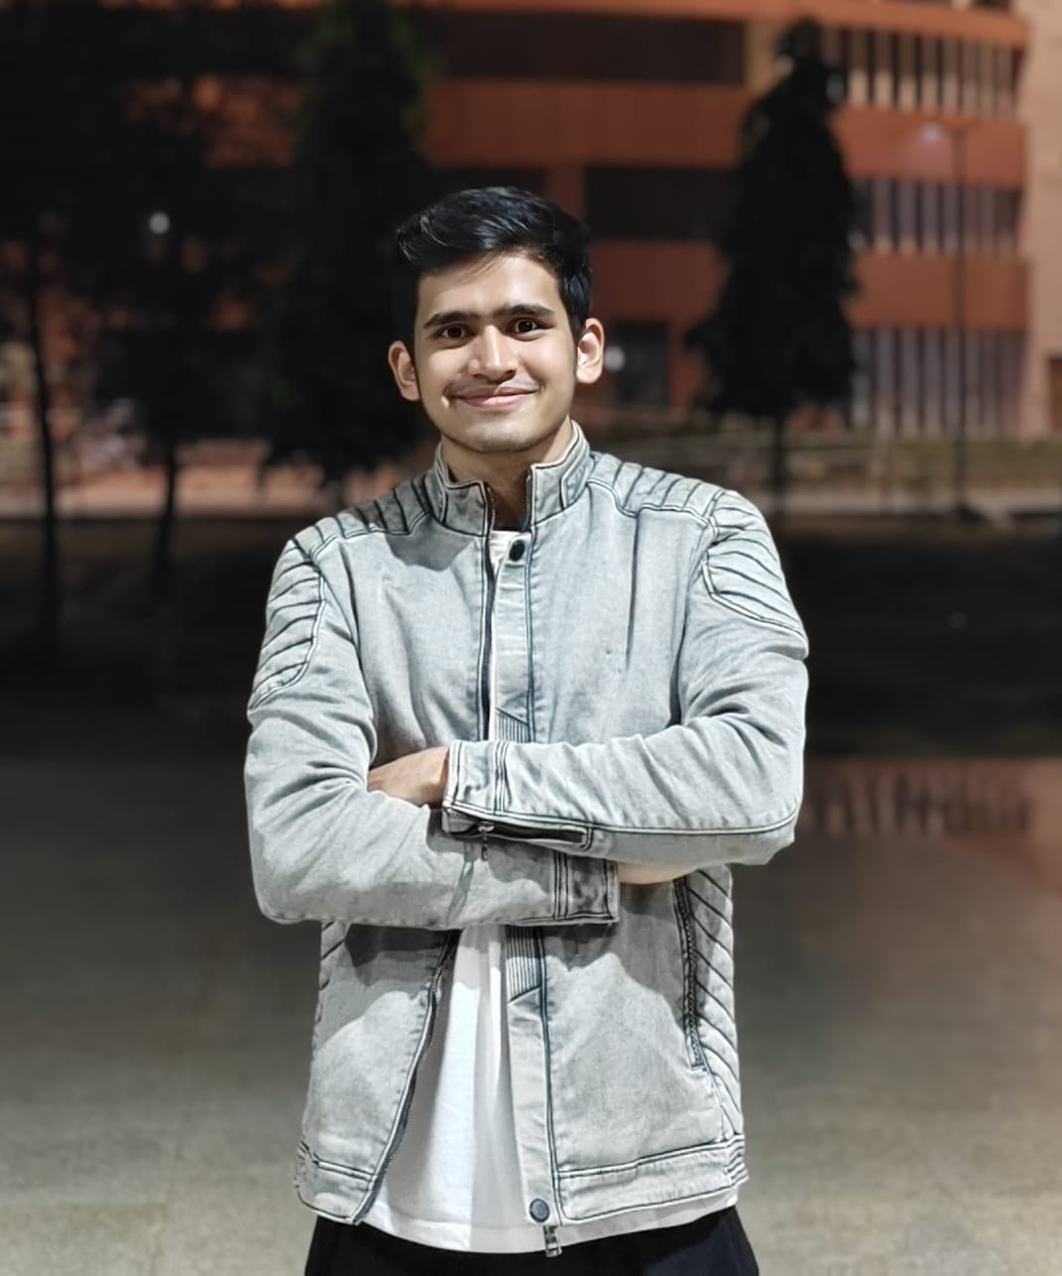
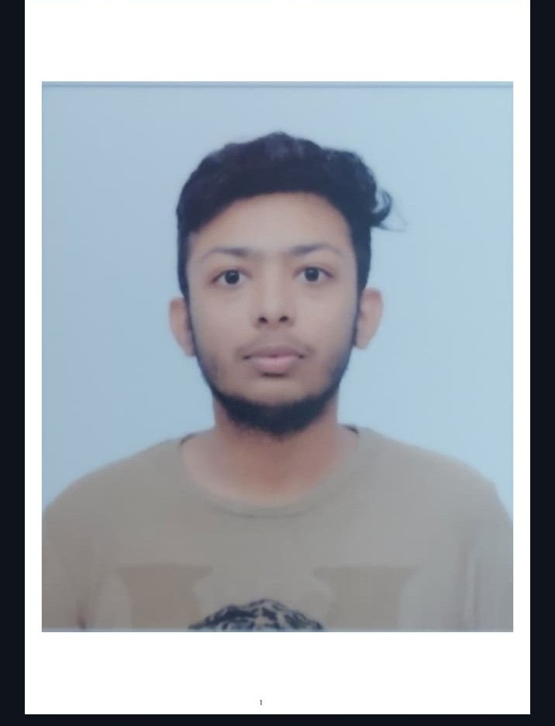
Team details
TEAM NAME: Warriors
Harsh Singh Baghel
Dhruv Maheshwari
College: IIT Patna
Stream: Engineering Physics
Year of graduation: 2028
College: IIT Patna
Stream: Engineering Physics
Year of graduation: 2028
Rathod Rudra
Photo
College: IIT Patna
Stream: Engineering Physics
Year of graduation: 2029
All fields are mandatory

Slide 3
Describe the problem statement (200 words)
Today’s modern enterprise dashboards are great at telling you what’s happened but absolutely useless when it comes to telling you why and what to do next. If there is an abnormality in a critical KPI – say, regional revenue drops by 8% - a dashboard highlights a red KPI value. It is impossible to know if the problem is due to some kind of internal failure (deployment error, backlog of goods, malfunctioning payment gateway) or to an external macro-level shock (supply chain issues, new tariffs, or competitor price war).
As a result, interpretation of metric deviations into business insights has become the responsibility of human analysts. Such analysis requires several days spent on a painstaking manual process of digging through SQL databases, Jira tickets, Slack channels, and global news articles.
This problem of human bottleneck leads to three significant risks for enterprises:
Critical Latency: By the time the root cause is found 4 to 7 days later, it is too late, and revenue losses become permanent.
Alert Fatigue: People spend precious time investigating normal seasonality deviations as if it were an alert.
Decision-making Guesswork: Leadership is making million-dollar decisions based on gut feeling because of lack of insight.

Slide 4
Proposed solution (200 words)
How We Find the Real Root Cause (The Diagnostic Engine):
Instead of relying on a single, generic AI that guesses why numbers dropped, our system uses a smart, multi-step investigation.
First, we use simple math called Statistical Process Control to filter out normal daily fluctuations. This ensures our AI ignores regular weekend dips and only wakes up when there is a genuine business anomaly, saving time and preventing alert fatigue.
Once a real issue is confirmed, two specialized AI models start investigating at the same time:
Model 1 (The Private Internal Expert): We fine-tune this model on over 100,000 real-world business failure patterns. It runs completely inside the company’s own secure servers. It privately checks internal operational logs, warehouse inventory, software bugs, and customer support tickets to pinpoint internal mistakes without leaking sensitive company secrets.
Model 2 (The Live Global Sentinel): This model connects directly to real-time internet and news feeds. It looks at the outside world to catch external shocks your internal database knows nothing about—such as sudden port strikes, raw material price spikes, or aggressive competitor discount campaigns.

Slide 5
Proposed solution (200 words)
How We Simulate the Future & Drive Action (The Decision Engine):
Finding the problem is only half the battle; leaders need to know what will happen next and what action to take. This is where our third model takes over:
Model 3 (The Decision & Simulation Engine): It brings together the findings from Model 1 and Model 2. Using causal logic, it calculates the exact cause—such as "70% of this drop was caused by the shipping strike, and 30% was our internal warehouse backlog." If the data is ever unclear, it never hallucinates an answer; instead, it gives honest probability percentages and suggests a quick, low-cost test to confirm the truth.
Simulating the Future Before You Spend Money: Before taking action, Model 3 projects what will happen over the next 30, 60, and 90 days for every possible solution. It forecasts how much revenue you will recover, how much the fix will cost, and any potential business risks.
Blending with Human Intuition: Business leaders are always in control. Executives can easily add their own qualitative judgment or budget limits and the model instantly recalculates the recovery plan to match their strategic vision.

Slide 6
Thank you

